Slide 1


Oracle Cloud ERP
Managing My Receipts

Slide 2

Welcome
Please briefly share the following information about yourself:
  Name
  Department and Role
  One non work-related fun fact about you
  Your familiarity with the Oracle ERP system

Slide 3



Housekeeping
A 15-minute break
will be taken
approximately every 2 hours
Help manage activities by starting and stopping on time
Feel free to
ask questions
Actively listen and participate in presentations

Slide 4




Ground Rules
Silence cell phones
Check E-mail during breaks ONLY
Do not work on computers during instructor presentations
Provide feedback to improve training
Minimize side conversations/chats

Slide 5


Course Prerequisites
You should have completed the following courses before attending class today:
  Oracle General Overview, Navigation, and Reporting

Slide 6
Course Objectives
Upon completion of this course, you should be able to explain the processes involved with managing receipts, which includes :
  Receiving a requisition line
  Viewing a receipt
  Correcting a receipt
  Returning a receipt
Notes:
Bullet Reference
Specific points of interest
Questions to ask the class
Example
Reminders for Instructor
Ask participants to introduce themselves and talk about their general experience in the xxxx area. (Include this note only in overview units - and delete this sentence)
Ask if there are any questions before you get started.
Some quick references listed may not be demonstrated in class, but are included in the Quick Reference Notebook. (Include this note only in overview units - and delete this sentence)

Slide 7

Course Components
Participant Guide
  Concepts
Activity Guide
  Exercises/Demonstrations
Job Aids
Course Evaluation

Slide 8

Course Modules
This course is intended to introduce you to managing the procurement receipts process in Oracle. In this course, participants learn about receiving a requisition line, correcting a receipt, and returning a receipt. The course is composed of the following modules:
  Module 1: Managing My Receipts
  Module 2: Summary

Slide 9
Key Receipt Terms
Key Term | Definition
RMA | Return Merchandise Authorization – Process to receive a refund, replacement, or repair of a product
Description | The description attached to the requisition that was originally created
Item Description | Field used to describe the specific item that was created (could be an inventory item or project description)

Slide 10
Managing My Receipts
Module One

Slide 11
Learning Objectives
Upon completion of this section, you should be able to:
  Describe the steps needed to receive a requisition line in Oracle
  Explain how to view a receipt
  Describe the steps needed to correct a receipt
  Explain how to return a receipt
Notes:
Bullet Reference
Specific points of interest
Questions to ask the class
Example
Reminders for Instructor
Ask participants to introduce themselves and talk about their general experience in the xxxx area. (Include this note only in overview units - and delete this sentence)
Ask if there are any questions before you get started.
Some quick references listed may not be demonstrated in class, but are included in the Quick Reference Notebook. (Include this note only in overview units - and delete this sentence)

Slide 12
What Is Changing?
Managing receipts using Oracle is a new process for Cable One requesters of Purchase Requisitions. With this process, there are specific items requesters receive/do not receive within Oracle.
Requesters are now tasked with receiving when they are given an invoice for a service or when service has been rendered:
  Non-Inventory Items (i.e., as part of a 3-way match for Suppliers to be paid by AP)
  Contract Labor receipts (authorizes an invoice to be paid by AP)
Requesters do NOT receive Inventory items at warehouse locations (includes common and project inventory). These are always received by the Warehouse Associate assigned to the receiving warehouse location
Users can only receive receipts THEY created. A user cannot receive receipts created by others

Slide 13
When Is A Receipt Performed?
A Requester processes a receipt when:
  They receive a physical item (expense item)
  Service has been completed and invoice is received
  Requester is aware of an outstanding receipt that must be processed
  Reviewing past due items based on due date that must be received (can be displayed to show due dates for 30/60/90 days or anytime)
  * Requester should get into the habit of performing a daily check on outstanding receipts and process that receipt as required

Slide 14
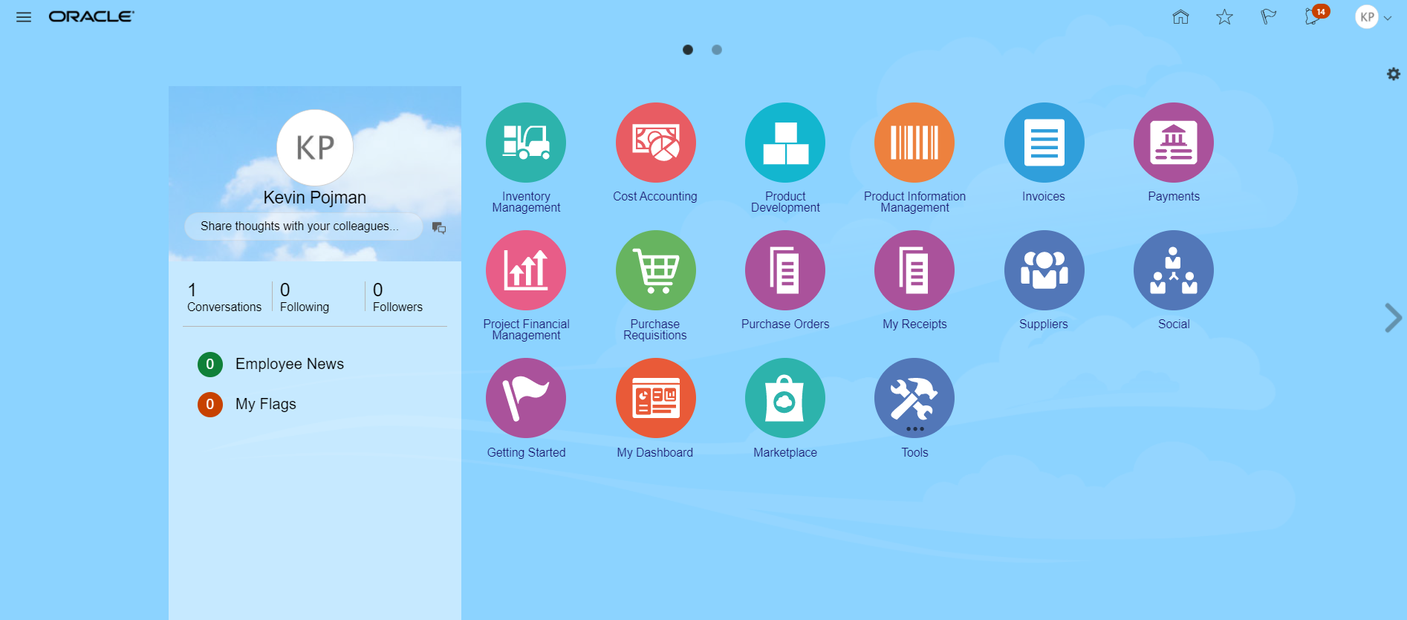
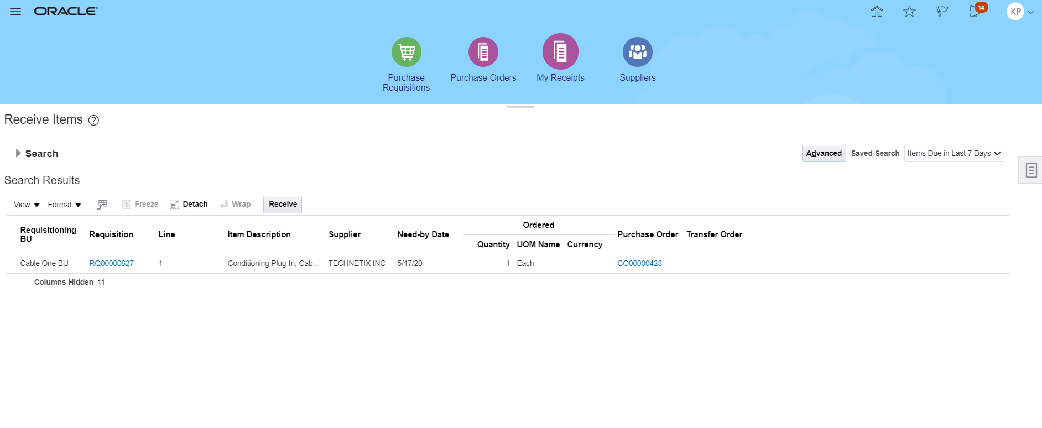
Receiving a Requisition Line
Purchase orders are used to initiate a transaction with a supplier when a business wants to purchase something. This allows both parties to have matching records they can use to verify what was purchased, the price of the transaction, and when the purchase took place.
Once on the Receive Items screen, Search based on Requisition or Purchase Order. Select displayed “open” (not fully received) requisition line(s) and Receive.
Click the My Receipts icon

Slide 15

Demo/Exercise
Receive a Requisition Line
Task Demo/Exercise
Demonstration
Notes:
To perform a Demonstration/Exercise:
Direct participants to the Quick Reference Notebook and ask that they follow along as you demonstrate the task.
Turn to the appropriate quick reference in the Quick Reference Notebook and demonstrate the entire transaction on the system by following the steps in the quick reference.
If there is an exercise, after completing the demonstration, distribute copies of the Exercise to the entire class. If there is not an exercise, answer any questions about the demo and go on to the next slide.

Slide 16
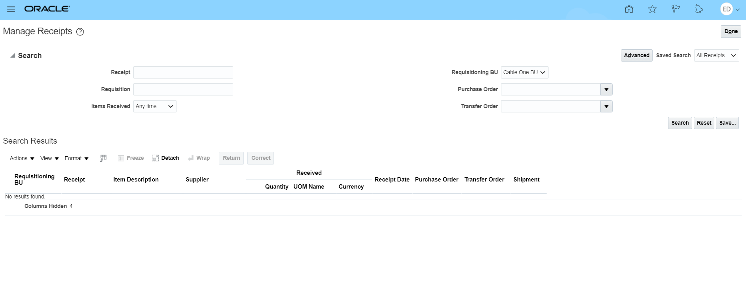
Viewing a Receipt
With the purchasing process integrating different parts of the organization, most departments (such as Finance) typically have access to view receipts when needed. With the view transaction, changes to the receipt are prohibited.
Once on the Manage Receipts screen, Search for Receipt based on Goods Receipt number, Requisition, or Purchase Order
From the Receive Items screen, click the Tasks Panel Tab icon and Choose “Manage Receipts”

Slide 17
Demo/Exercise
View a Receipt
Task Demo/Exercise
Demonstration
Notes:
To perform a Demonstration/Exercise:
Direct participants to the Quick Reference Notebook and ask that they follow along as you demonstrate the task.
Turn to the appropriate quick reference in the Quick Reference Notebook and demonstrate the entire transaction on the system by following the steps in the quick reference.
If there is an exercise, after completing the demonstration, distribute copies of the Exercise to the entire class. If there is not an exercise, answer any questions about the demo and go on to the next slide.

Slide 18
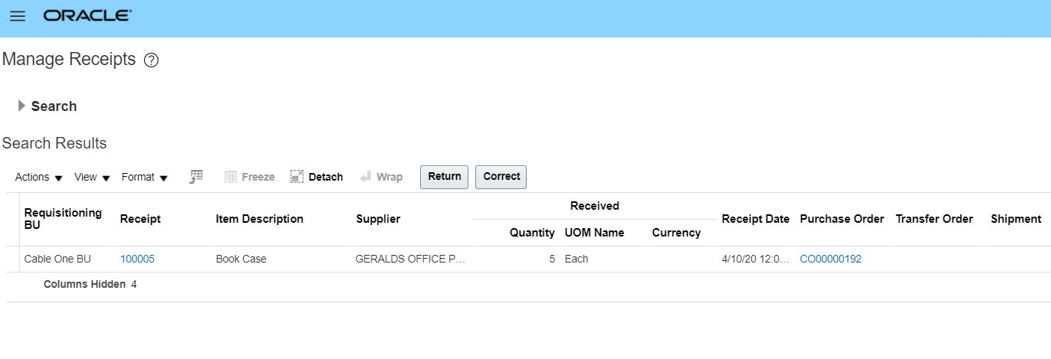
Correcting a Receipt
Requisitioners must ensure the correct quantity has been entered on the receipt. If not, they must correct the receipt.
On the Manage Receipts screen, Search for Receipt based on Goods Receipt number, Requisition, or Purchase Order.
Select desired Receipt and Correct. Ensure you are choosing the right Item and Goods Receipt.
Correct the Quantity, waybill, and Submit

Slide 19
Demo/Exercise
Correct a Receipt
Task Demo/Exercise
Demonstration
Notes:
To perform a Demonstration/Exercise:
Direct participants to the Quick Reference Notebook and ask that they follow along as you demonstrate the task.
Turn to the appropriate quick reference in the Quick Reference Notebook and demonstrate the entire transaction on the system by following the steps in the quick reference.
If there is an exercise, after completing the demonstration, distribute copies of the Exercise to the entire class. If there is not an exercise, answer any questions about the demo and go on to the next slide.

Slide 20
Returning a Receipt
Oracle provides you the option of returning a receipt. Rejected goods/services are returned to the supplier, as necessary. With inventory items, these are typically rejected and returned during inspection.
On the Manage Receipts screen, Search for Receipt based on Goods Receipt number, Requisition, or Purchase Order.
Select desired Receipt and Return. Ensure you are choosing the right Item and Goods Receipt.
Enter the Quantity returned & Supplier RMA number* (required) and Submit.
* When obtaining an RMA from the Supplier, request that they send a credit memo to Cable One Accounts Payable

Slide 21
Demo/Exercise
Return a Receipt
Task Demo/Exercise
Demonstration
Notes:
To perform a Demonstration/Exercise:
Direct participants to the Quick Reference Notebook and ask that they follow along as you demonstrate the task.
Turn to the appropriate quick reference in the Quick Reference Notebook and demonstrate the entire transaction on the system by following the steps in the quick reference.
If there is an exercise, after completing the demonstration, distribute copies of the Exercise to the entire class. If there is not an exercise, answer any questions about the demo and go on to the next slide.

Slide 22

Knowledge Check – True/False Question
Is the following statement True or False?
Oracle does not provide you the option of correcting a receipt once it’s been created. You must cancel the receipt and create a new one in its place.

Slide 23
Knowledge Check – True/False Answer
Oracle does not provide you the option of correcting a receipt once it’s been created. You must cancel the receipt and create a new one in its place.
False: Oracle provides you the option of correcting a receipt based on various changing business needs.

Slide 24
Knowledge Check – Question
When is a receipt typically rejected and returned?
When it is en route to the warehouse
During inspection
After it has been received
Prior to being shipped from the supplier location

Slide 25
Knowledge Check – Answer
When is a receipt typically rejected and returned?
When it is en route to the warehouse
During inspection
After it has been received
Prior to being shipped from the supplier location

Slide 26
Course Summary
Module Two

Slide 27
Course Summary
Having completed this course, you should be able to explain the processes involved with managing receipts, which includes:
  Receiving a requisition line
  Viewing a receipt
  Correcting a receipt
  Returning a receipt

Slide 28
Additional Help Resources
Additional Help Resources available for use:
  Training courses, Job aids, and additional support materials are available on SharePoint: [Enter ESO SharePoint URL]
  Oracle Help Desk: [Enter contact details]
  All other Cable One Processes: [Enter contact details]
  IT Help Desk: [Enter contact details]
  [Remedy ticketing tool]

Slide 29

Course Evaluation
Your responses provide the Cable One Training Team with feedback that is used to continuously improve the training program
Instructor will provide access to the class evaluation

Slide 30

Congratulations
You have completed the Oracle Cloud ERP Managing My Receipts Course

Slide 31
Thank You

